Slide 1

Data-Efficient Strategies for Object Detection
IbPRIA 2025
Dinis Costa & Joana Costa
June 30

Slide 2
Tutorial Goals
Train an Object Detection model on custom data
01
Use Active Learning to reduce annotation workload
02
Understand how annotation quality affects model performance
03
Apply Transfer Learning to boost performance and reduce training time
04
Notes:
Justificar que é um tutorial mais pratico

Slide 3

Agenda

Slide 4
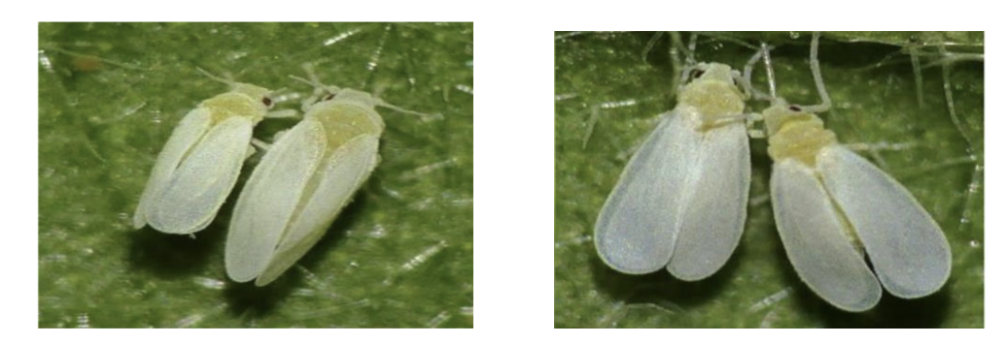
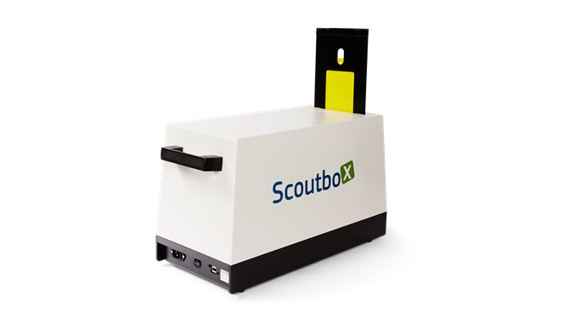
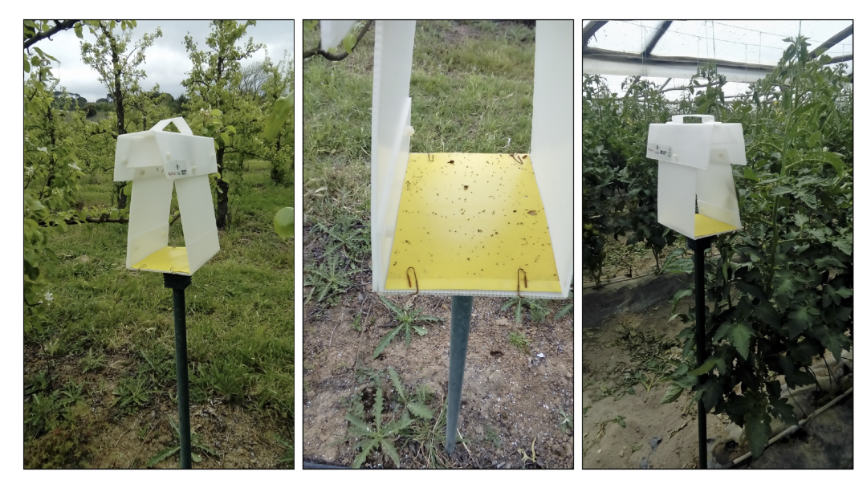
Case Study
Pest detection - importance

Slide 5
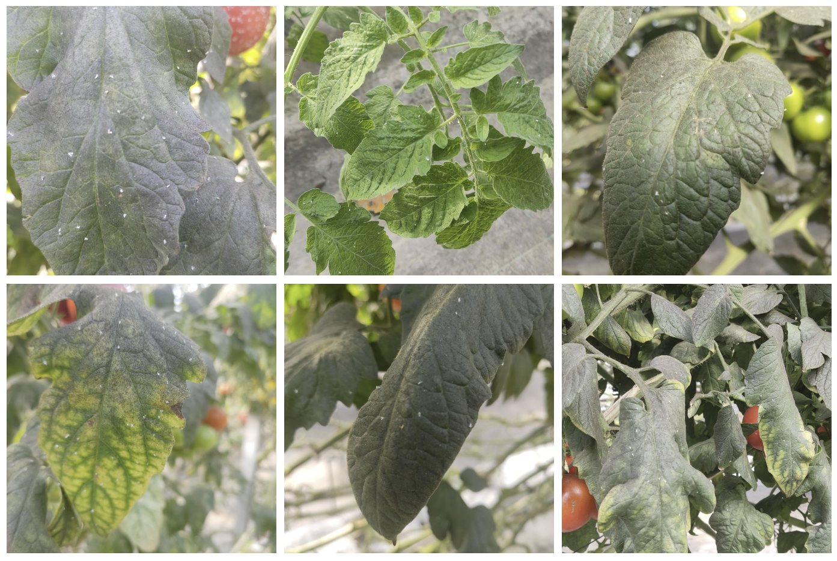
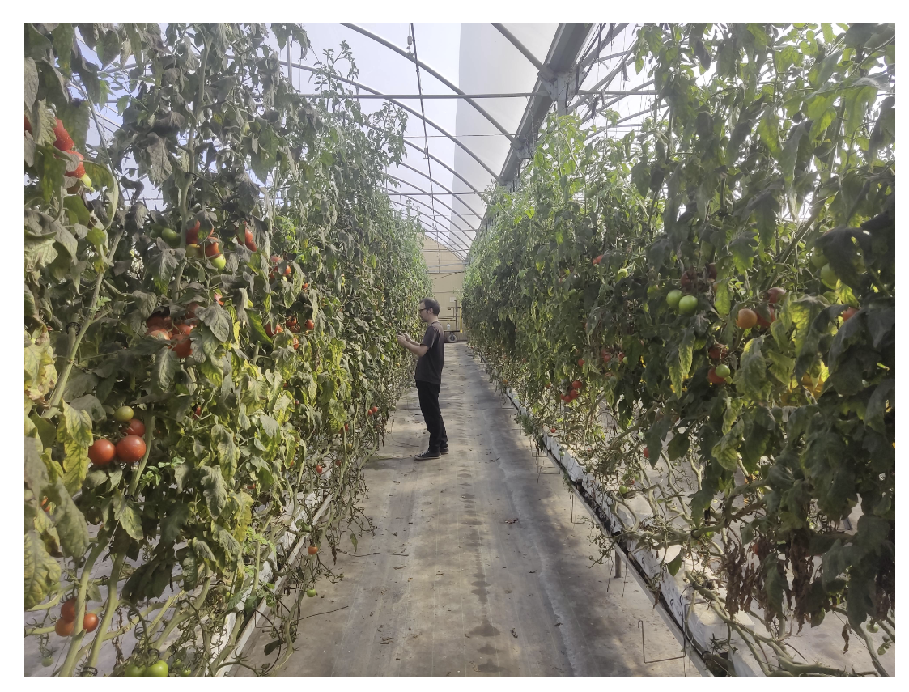
Data Collection, Preprocessing & Annotation

Slide 6
State-of-the-Art in Object Detection
One Stage vs Two Stage – key diffs
RCNN, Fast-RCNN, Faster Rcnn
YOLO1,2,3,4,5,6,7,8,9,10,11, SSD
Why YOLO why v5?
Metrics (Iou, mAP) Experimentação talvez toda no v11, apenas transfer learning no v5 pe temos o modelo do bruno

Slide 7
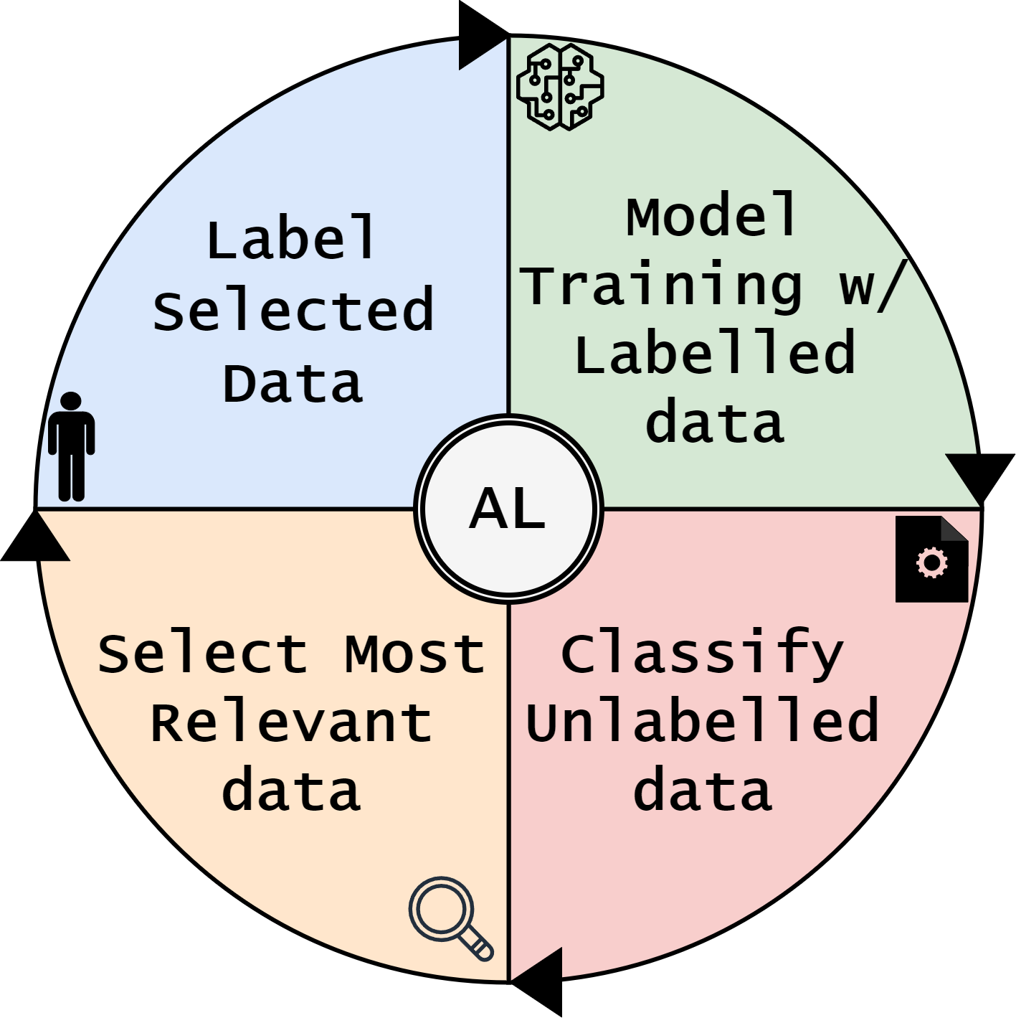
Active Learning

Slide 8
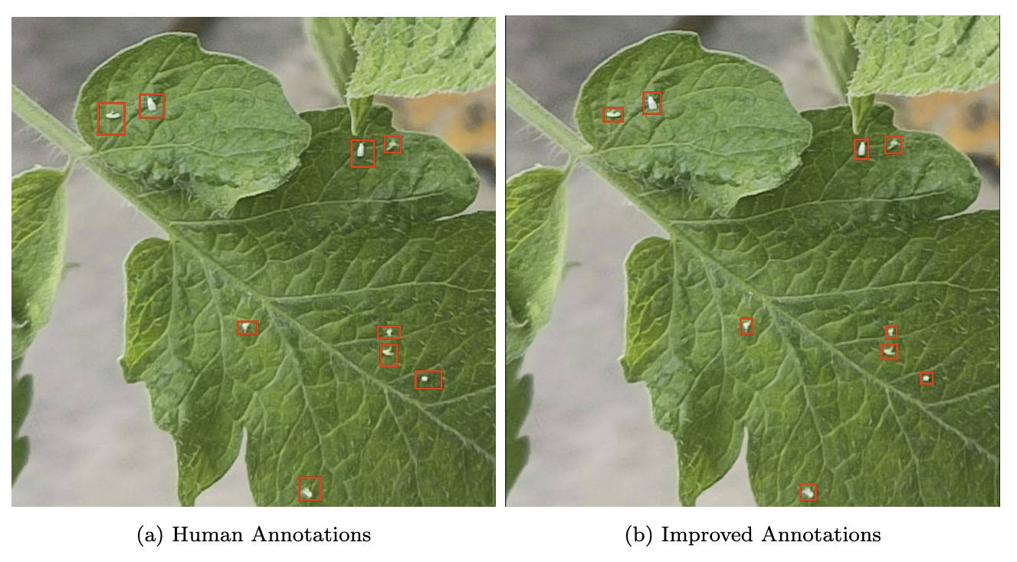
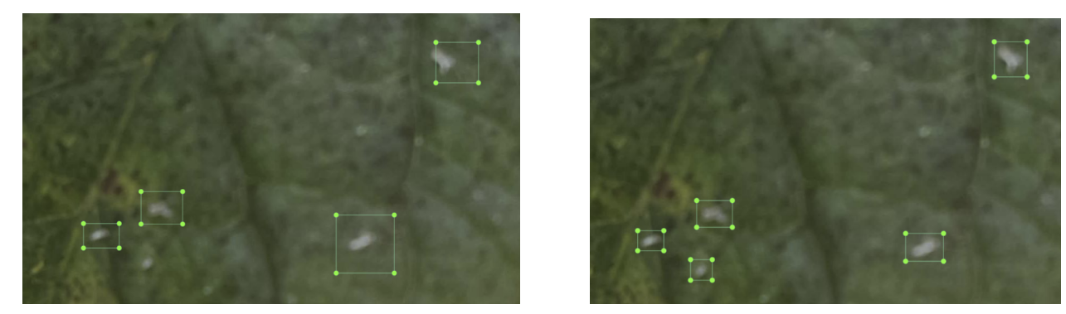
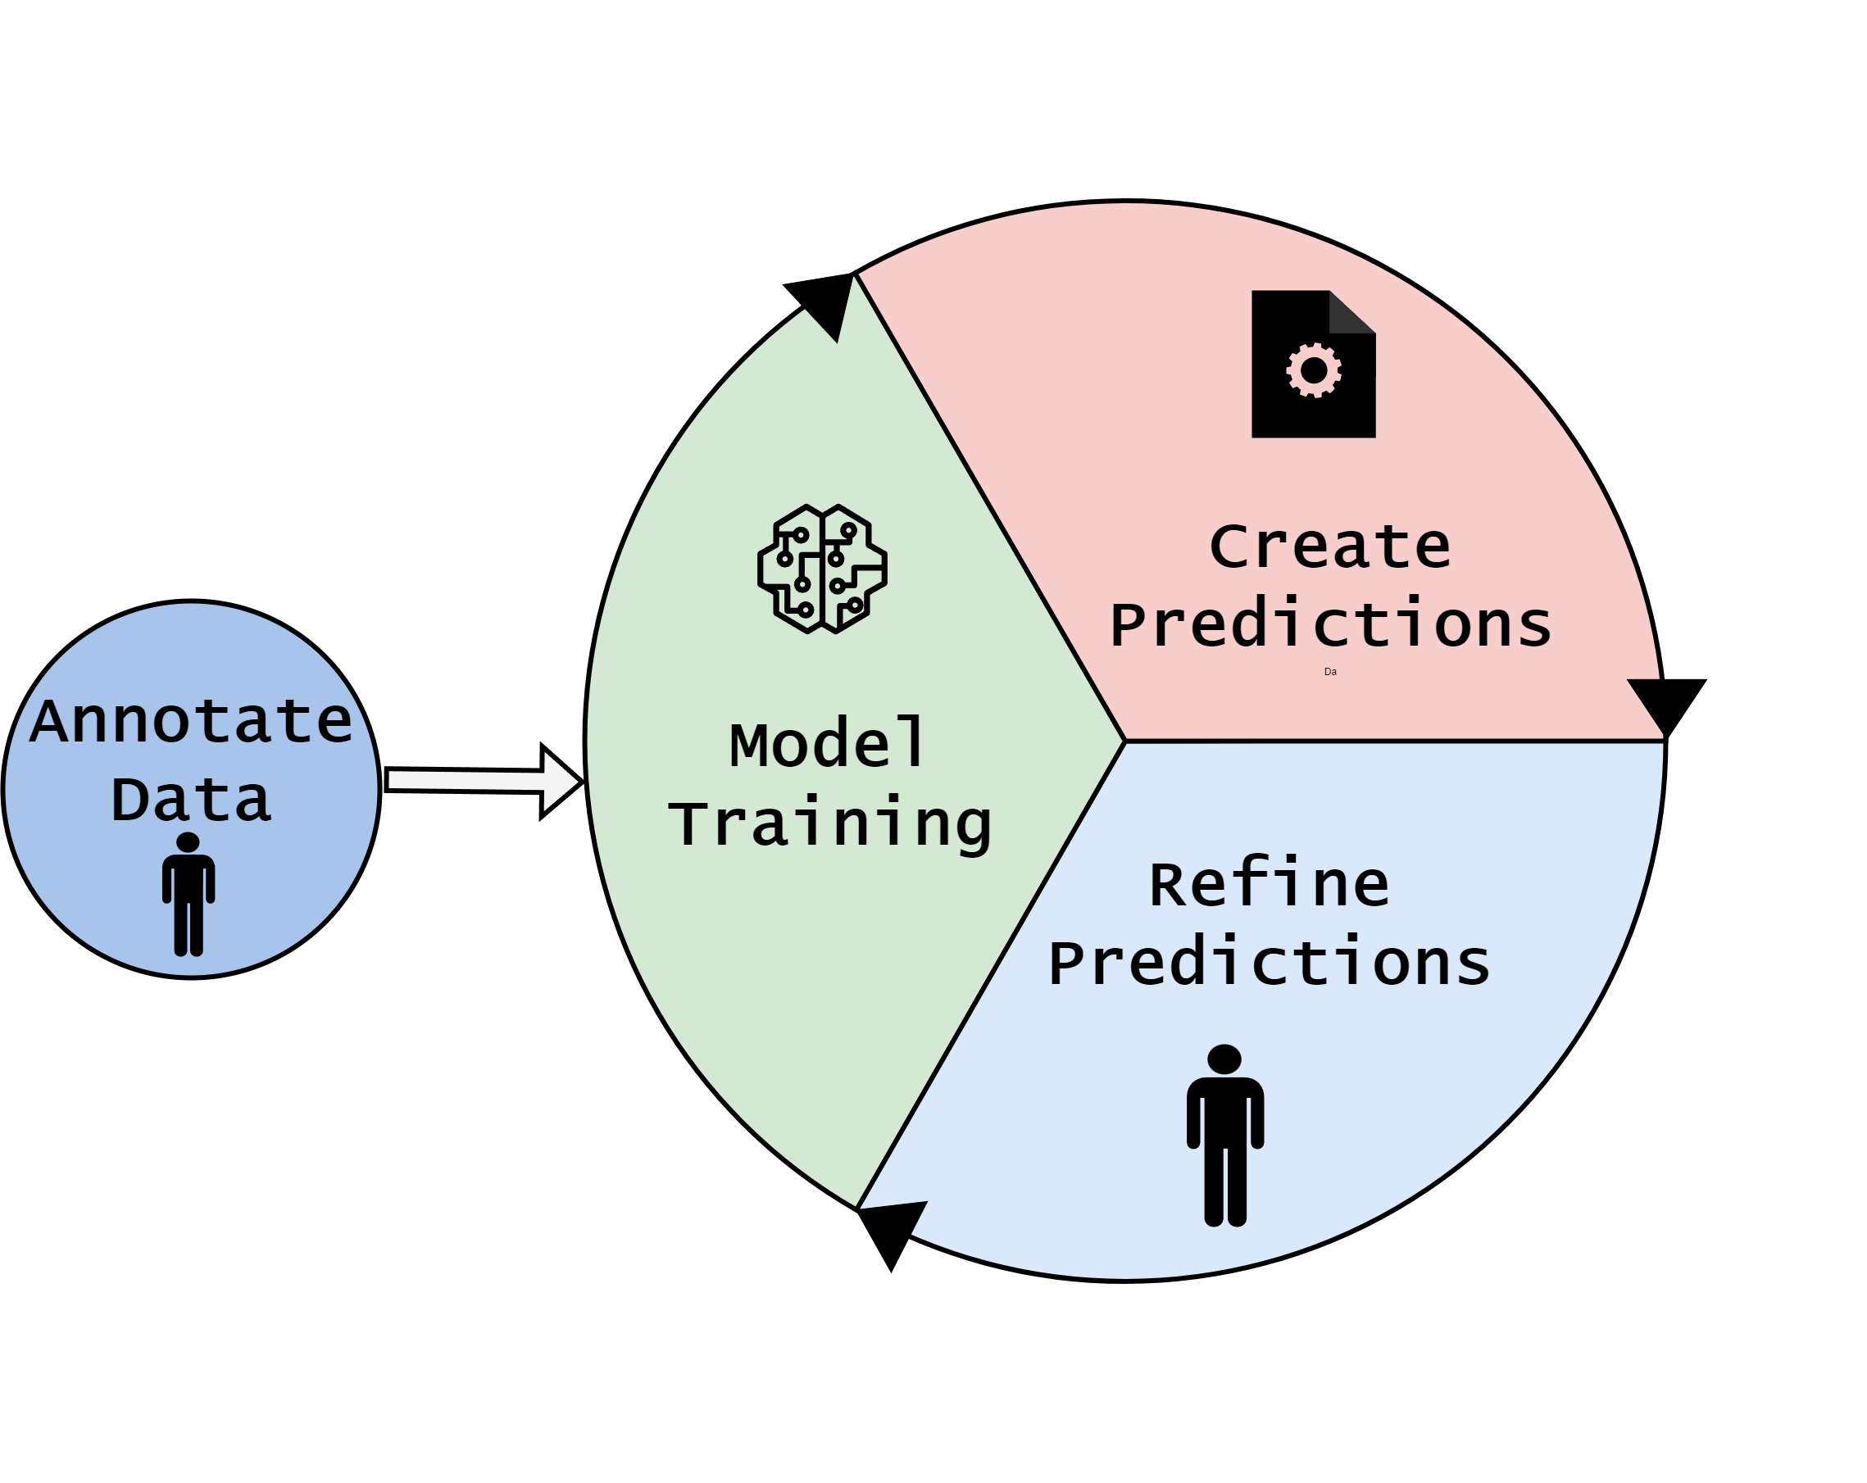
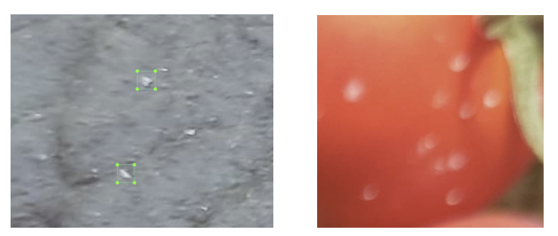
Data Quality
Key diffs
Impact
Ponte para mAP IoU - bbox

Slide 9
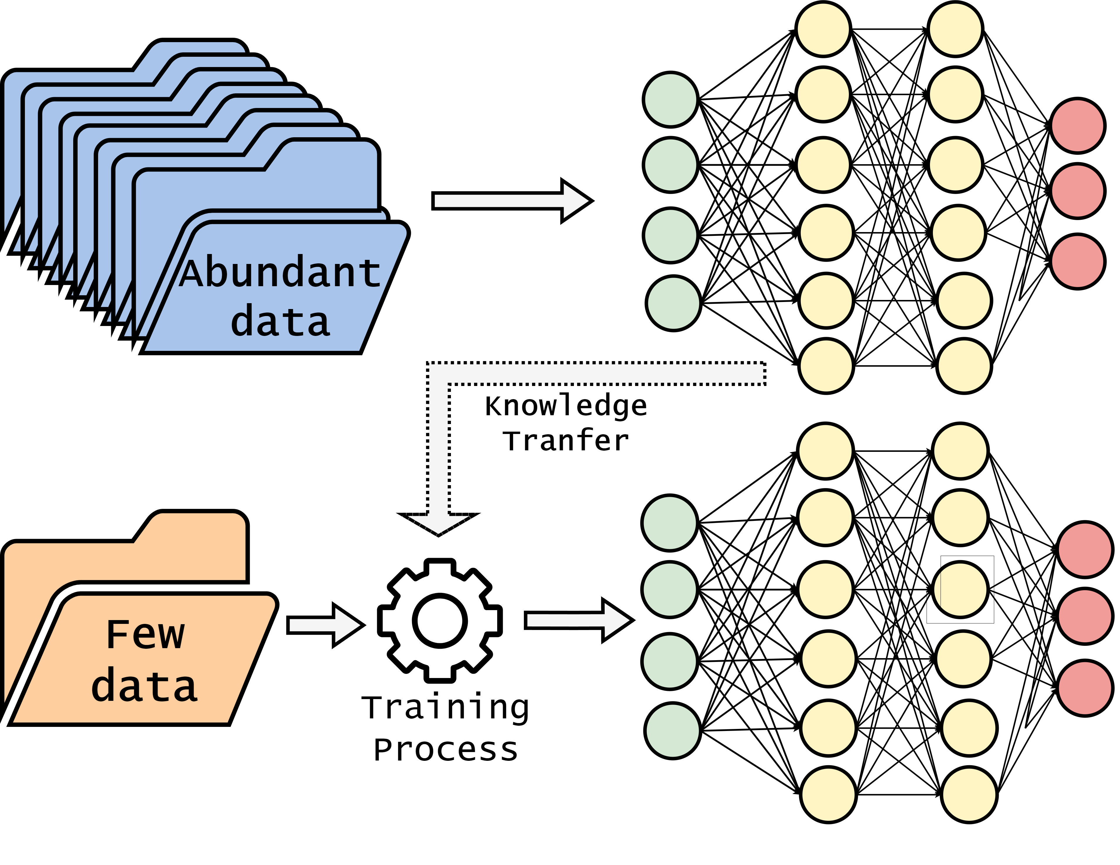
Transfer Learning

